Slide 1
Wikipedia Network
Jeremy Neiman Avigail “Sistah” Vantu

Slide 2
Five Cities
Moscow
New York
Shanghai
Istanbul
Tokyo

Slide 3
Five Languages
English – 550,000 Nodes
Türkçe – 88,000 Nodes
русский – 208,000 Nodes
日本語 – 250,000 Nodes
中文 – 285,000 Nodes

Slide 4
Five Languages
English – 550,000 Nodes
Türkçe – 88,000 Nodes
русский – 208,000 Nodes
日本語 – 250,000 Nodes
中文 – 285,000 Nodes

Slide 5
Methodology
Eigenvector Centrality
Top ~4000 Nodes
Community Detection with Modularity

Slide 6
Results

Slide 7
English

Slide 8
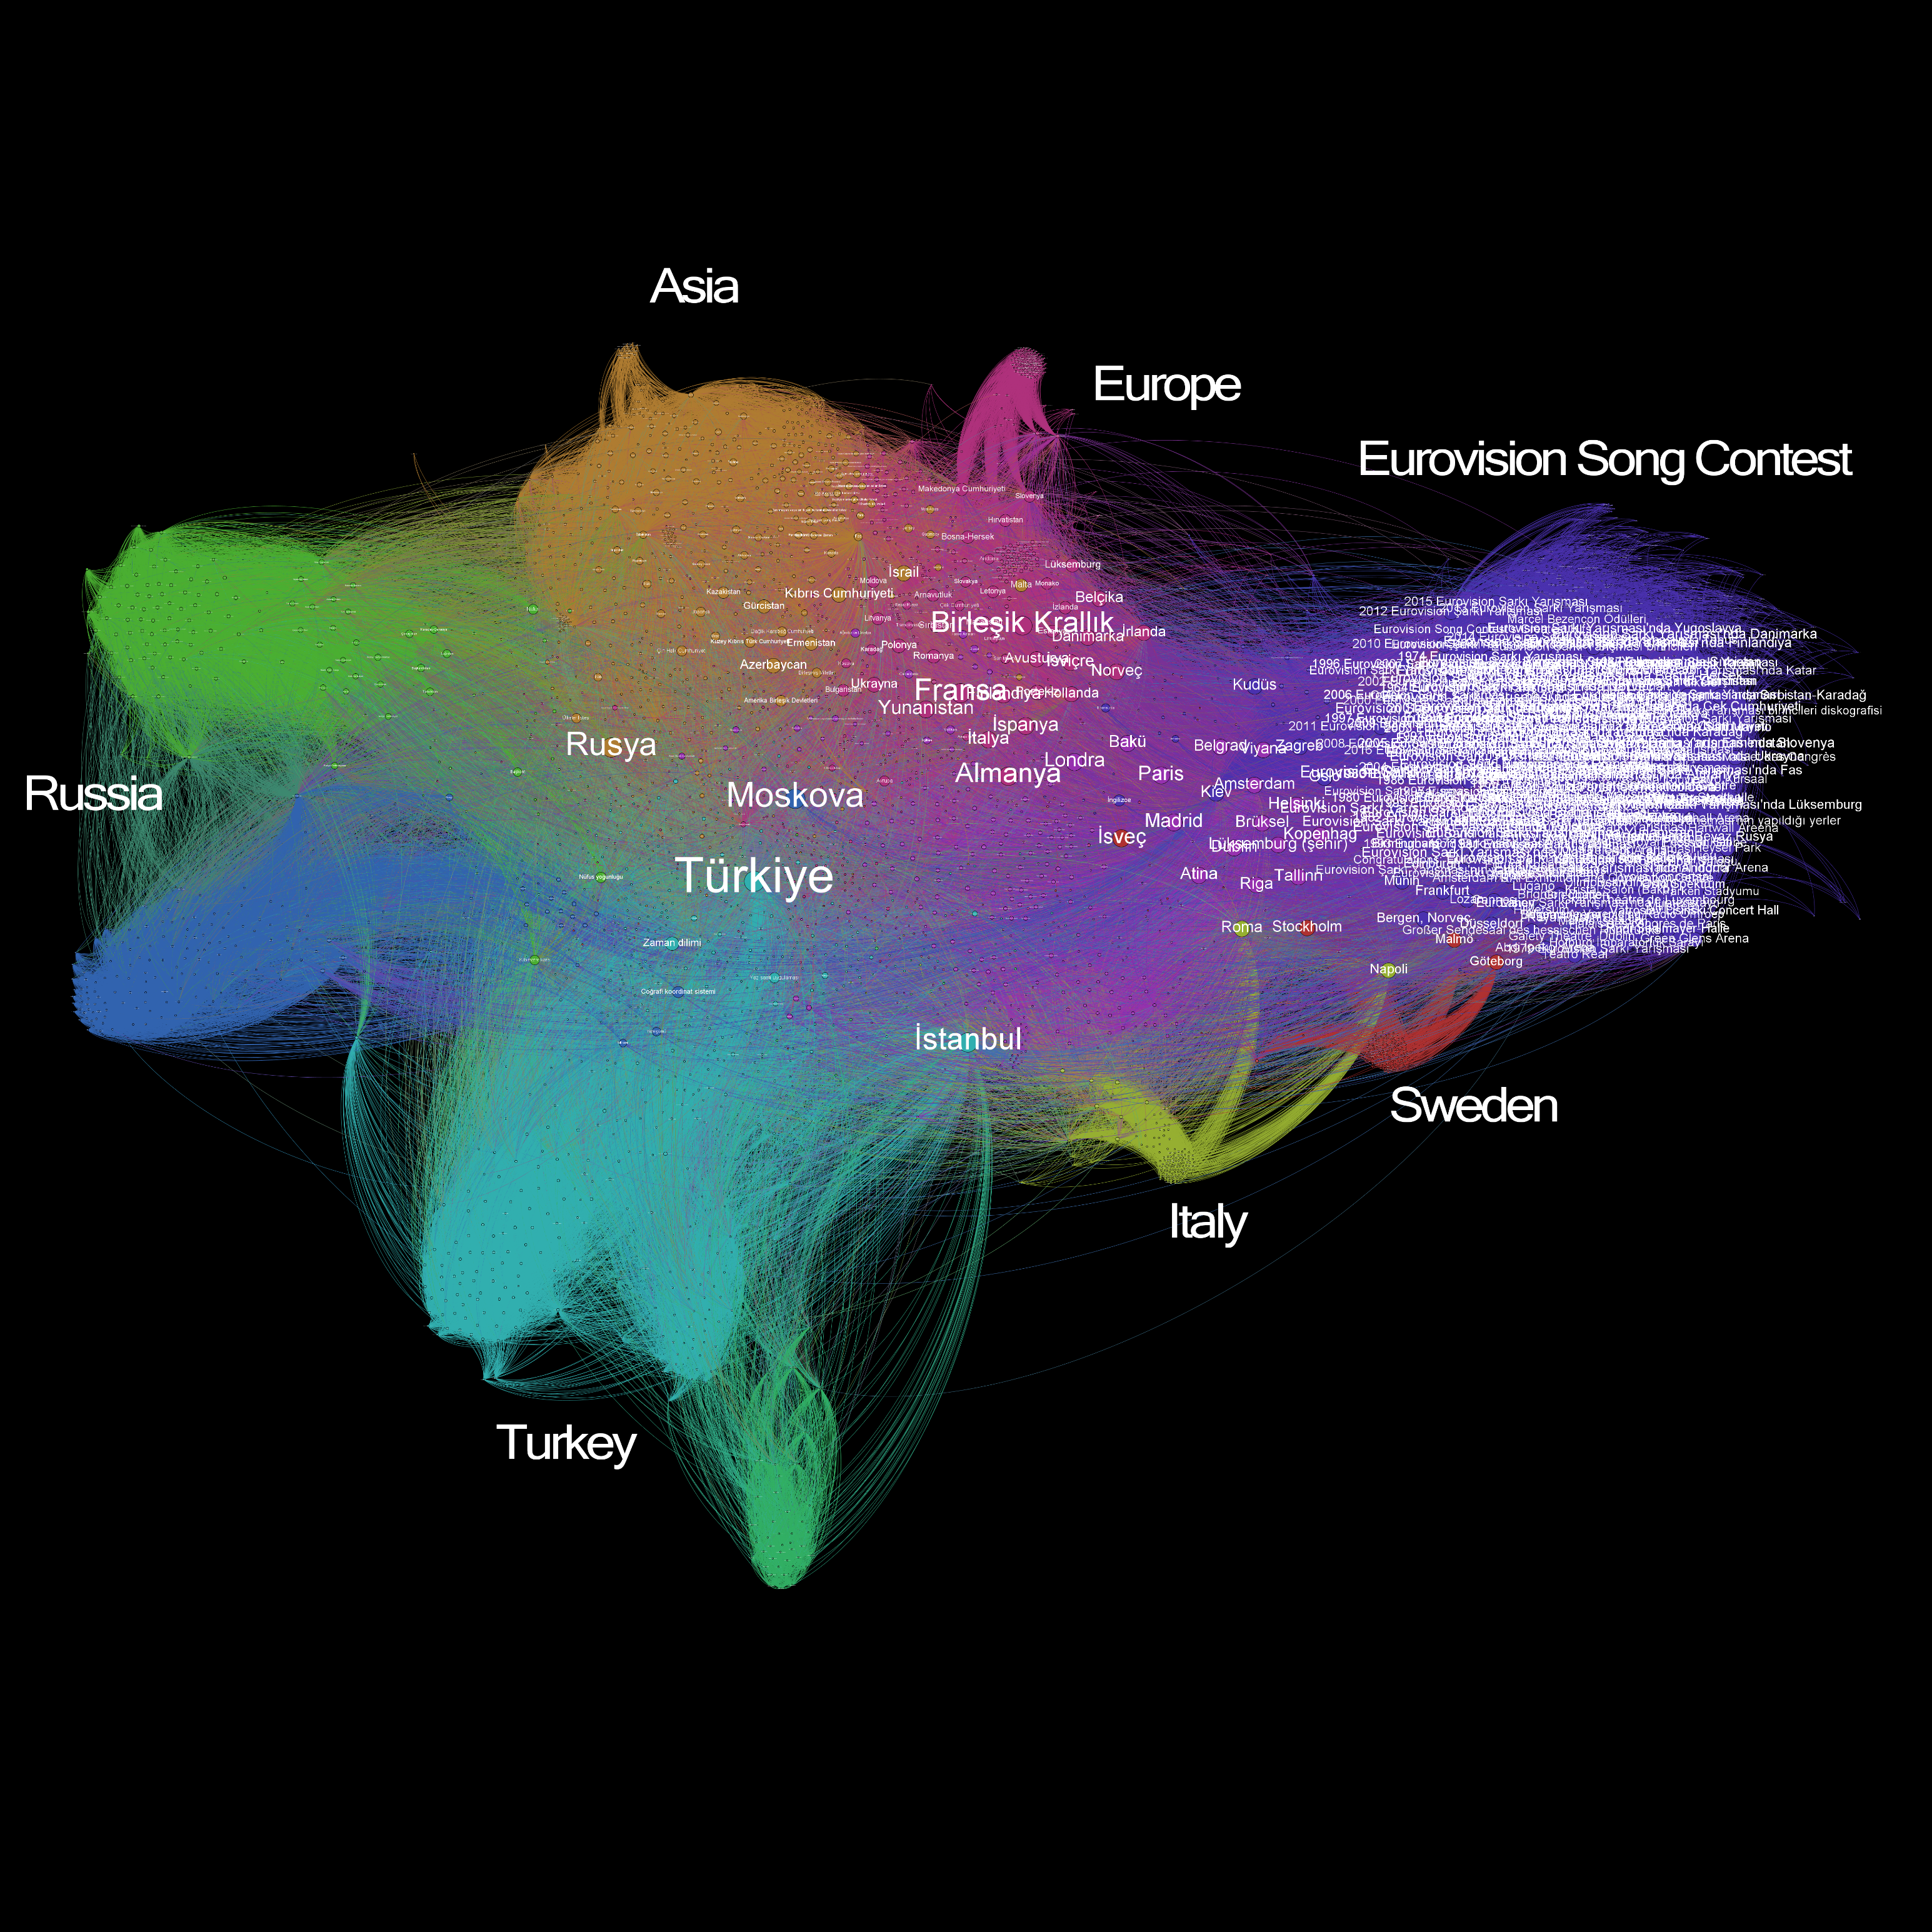
Turkish

Slide 9
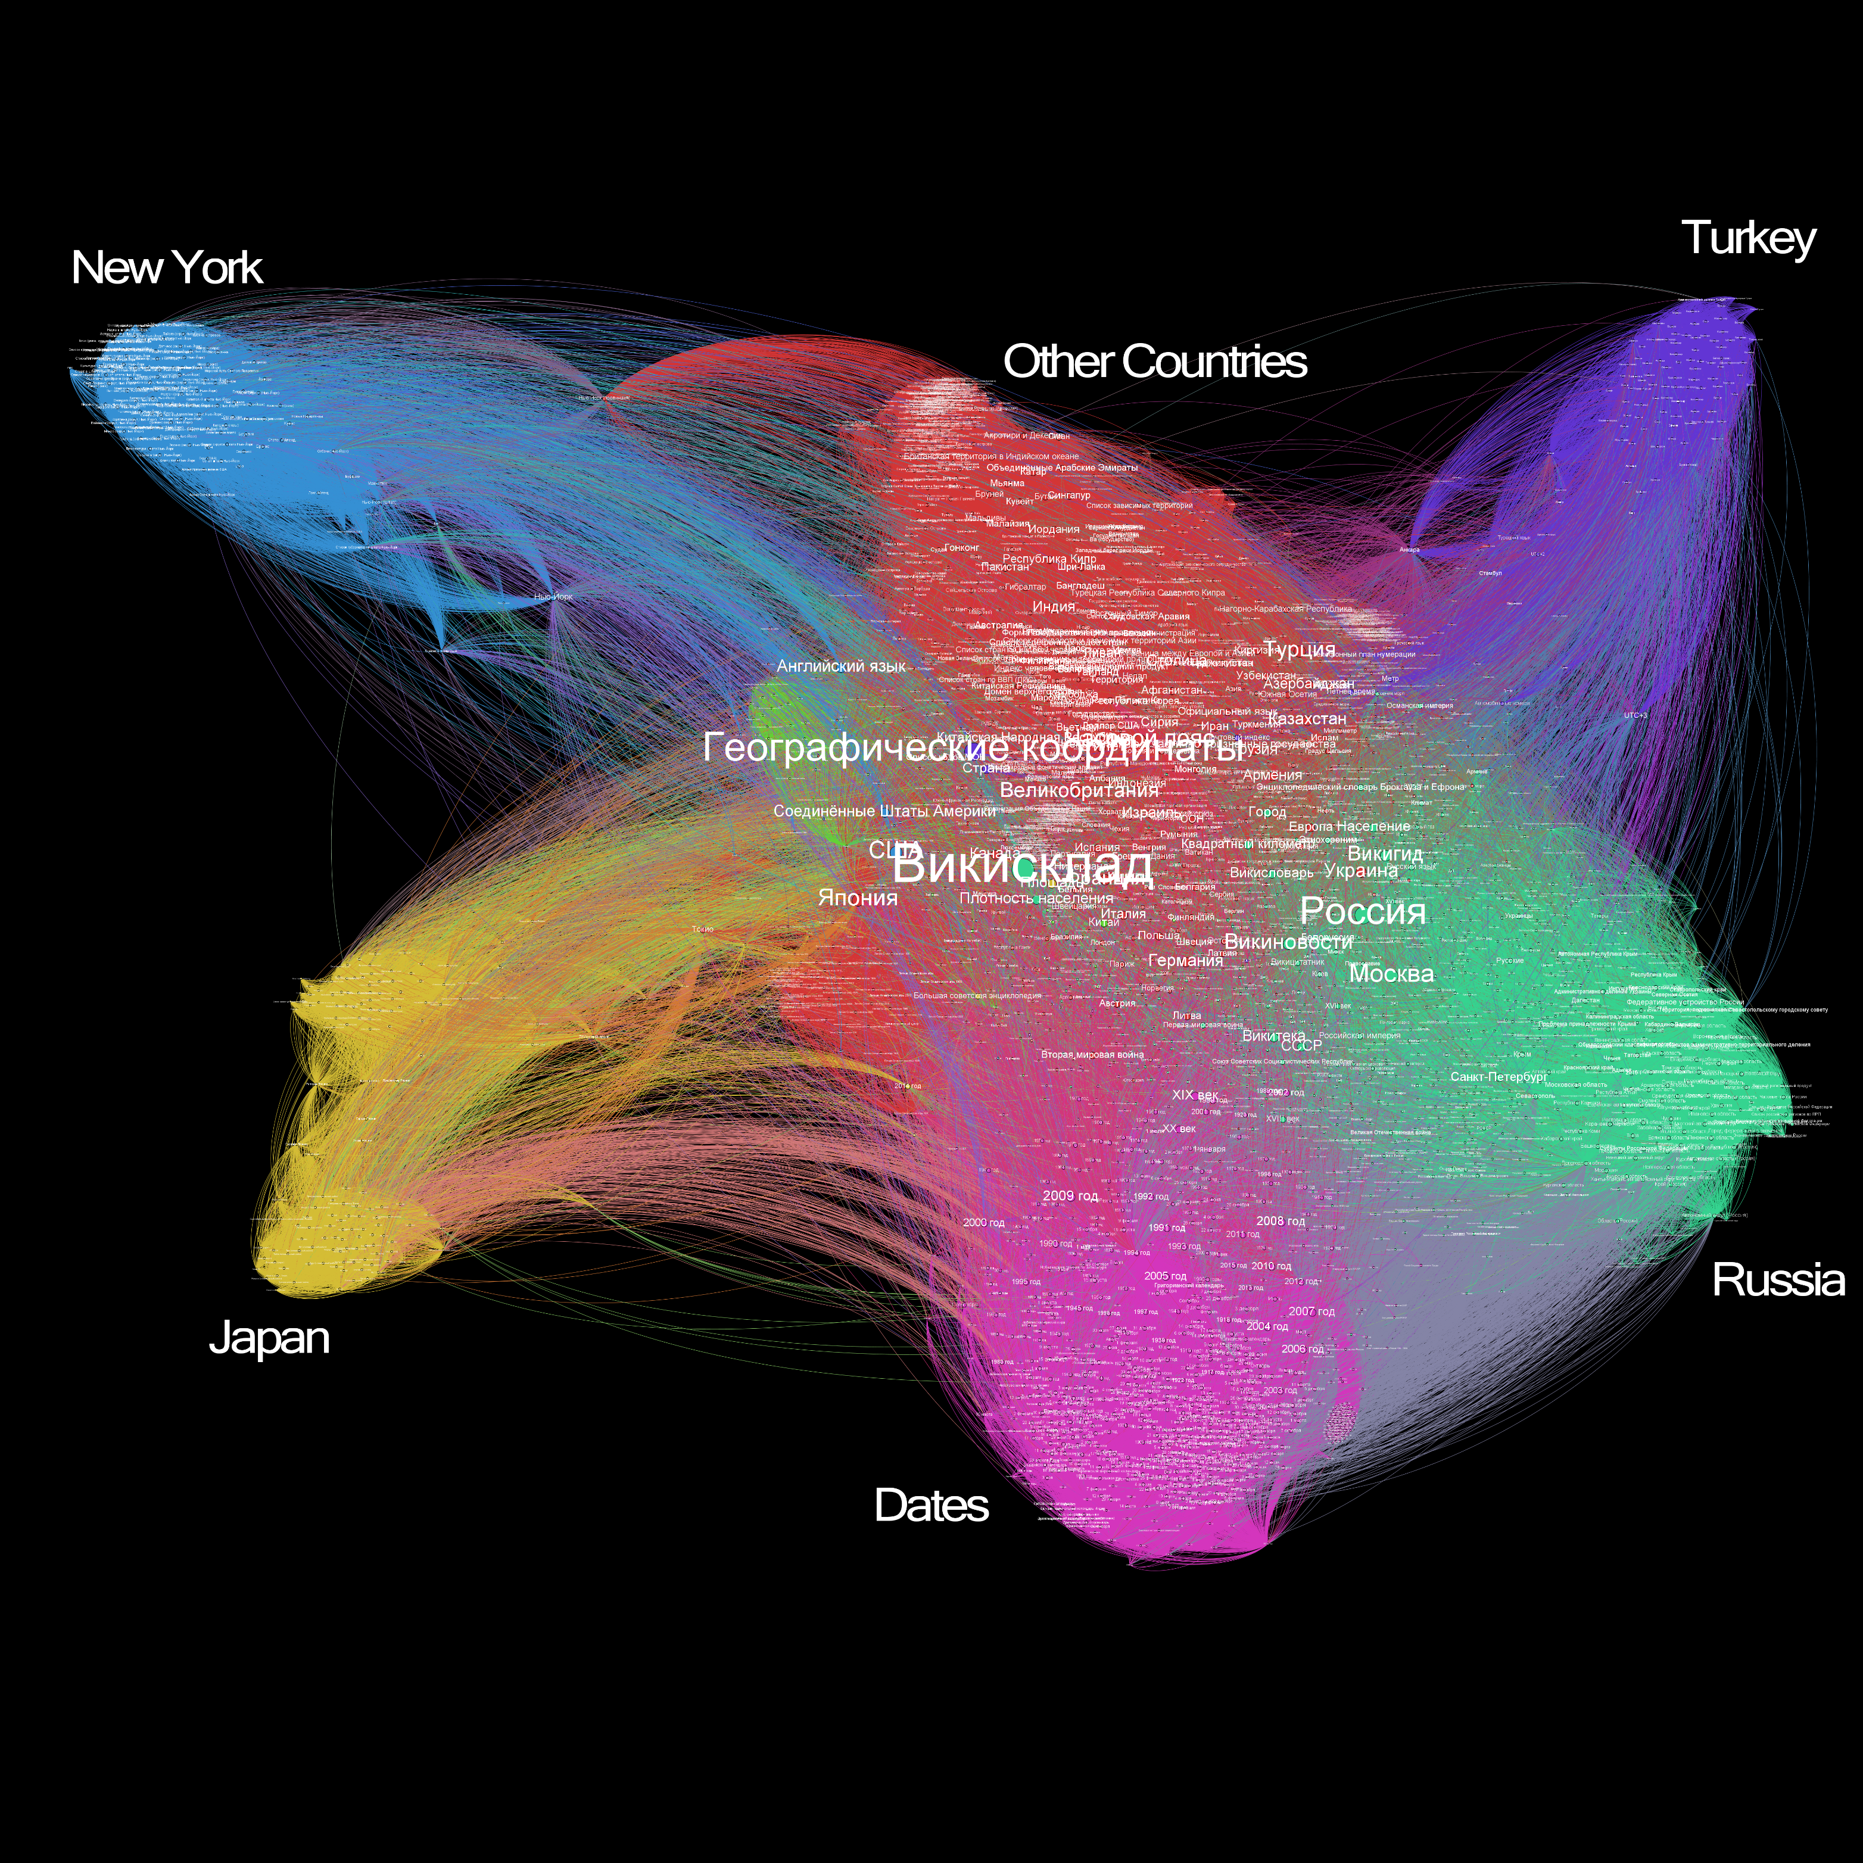
Russian

Slide 10
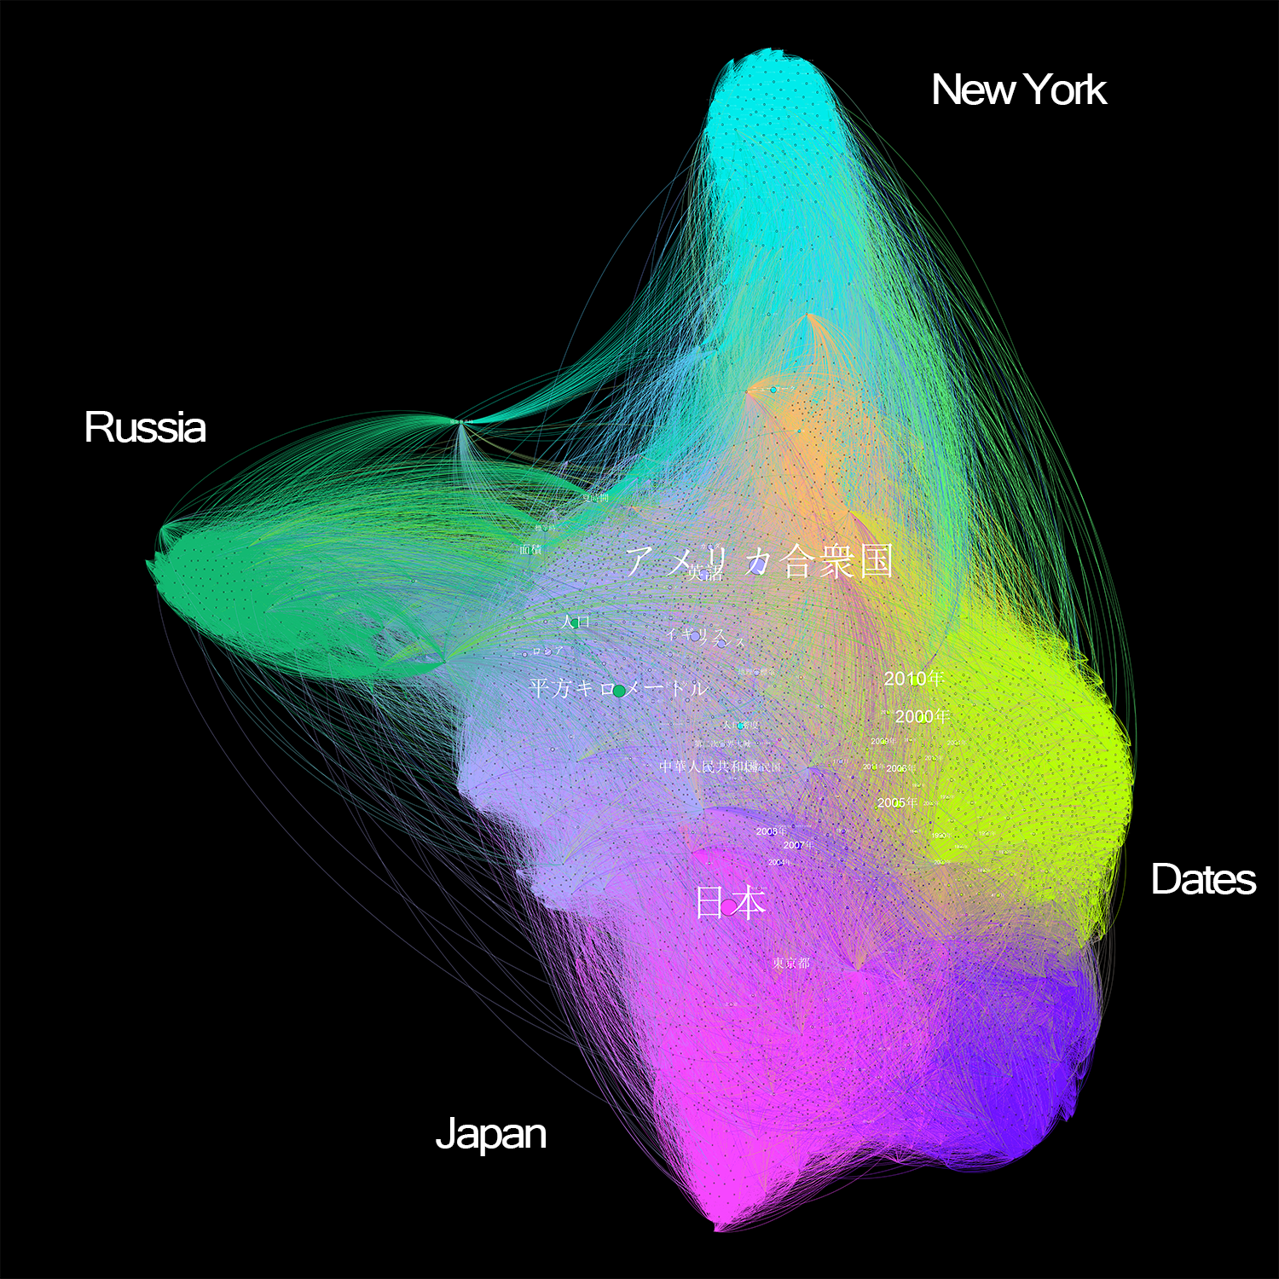
Japanese

Slide 11
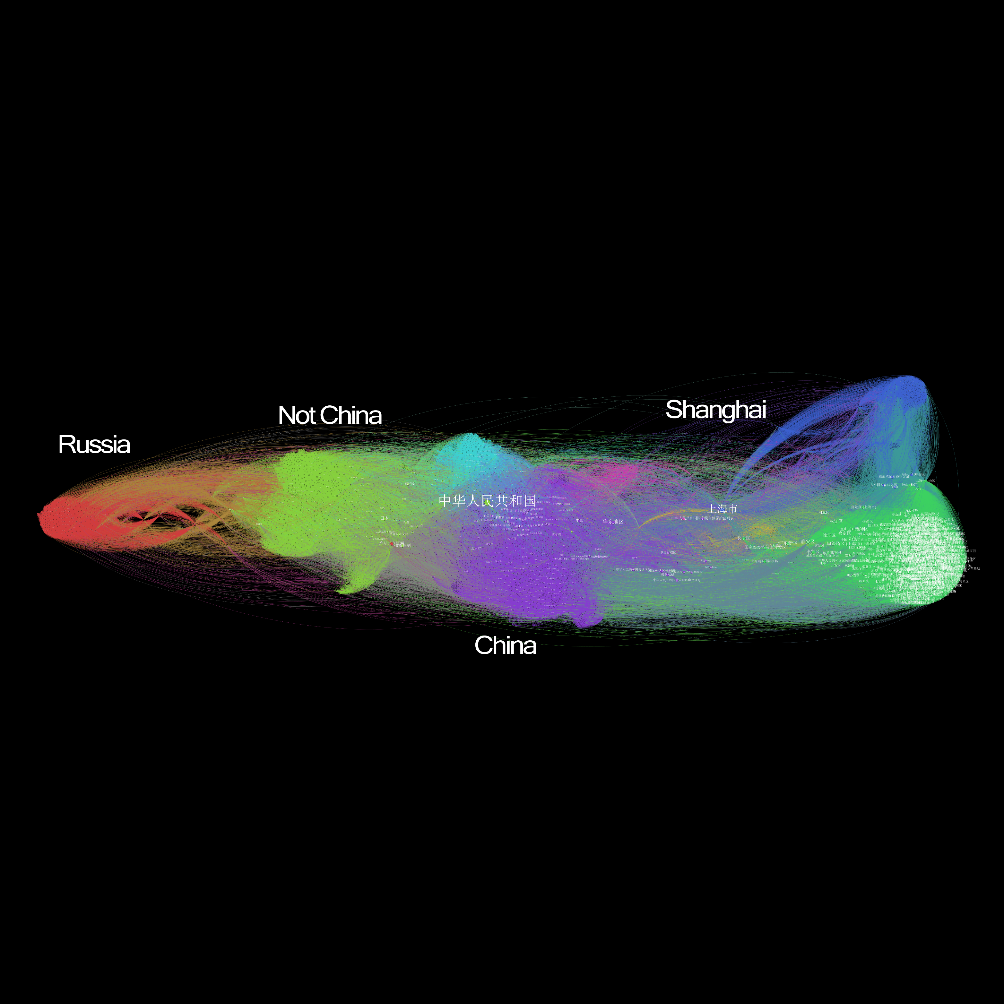
Chinese

Slide 12
Conclusions

Slide 13
Conclusions
Japanese New York
Chinese China
Turkish Eurovision
Russian Countries not cities
English Cities + Eurovision

Slide 14
Conclusions
Japanese New York
Chinese China
Turkish Eurovision
Russian Countries not cities
English Cities + Eurovision

Slide 15
Conclusions
Japanese New York
Chinese China
Turkish Eurovision
Russian Countries not cities
English Cities + Eurovision

Slide 16
Conclusions
Japanese New York
Chinese China
Turkish Eurovision
Russian Countries not cities
English Cities + Eurovision

Slide 17
Conclusions
Japanese New York
Chinese China
Turkish Eurovision
Russian Countries not cities
English Cities + Eurovision

Slide 18
Future
More languages and cities
Categorization
Social implications

Slide 19


